Slide 1
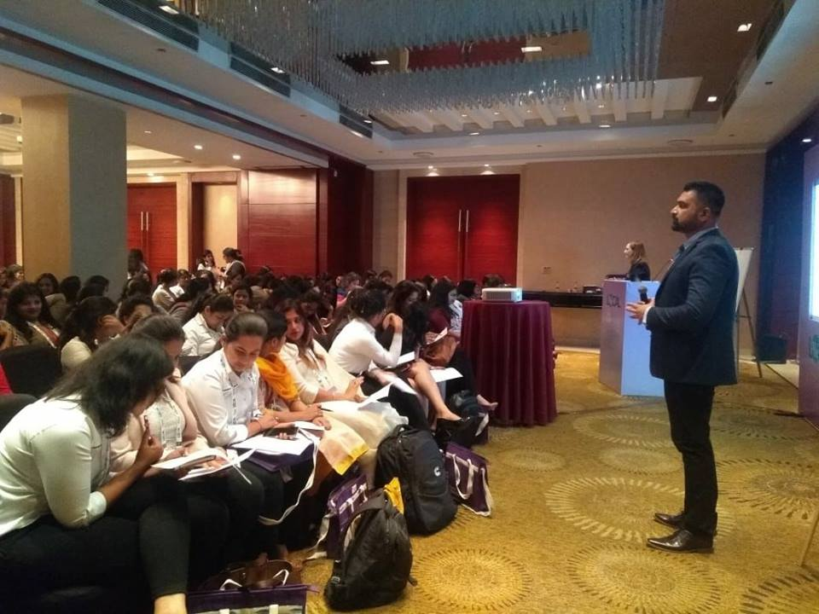
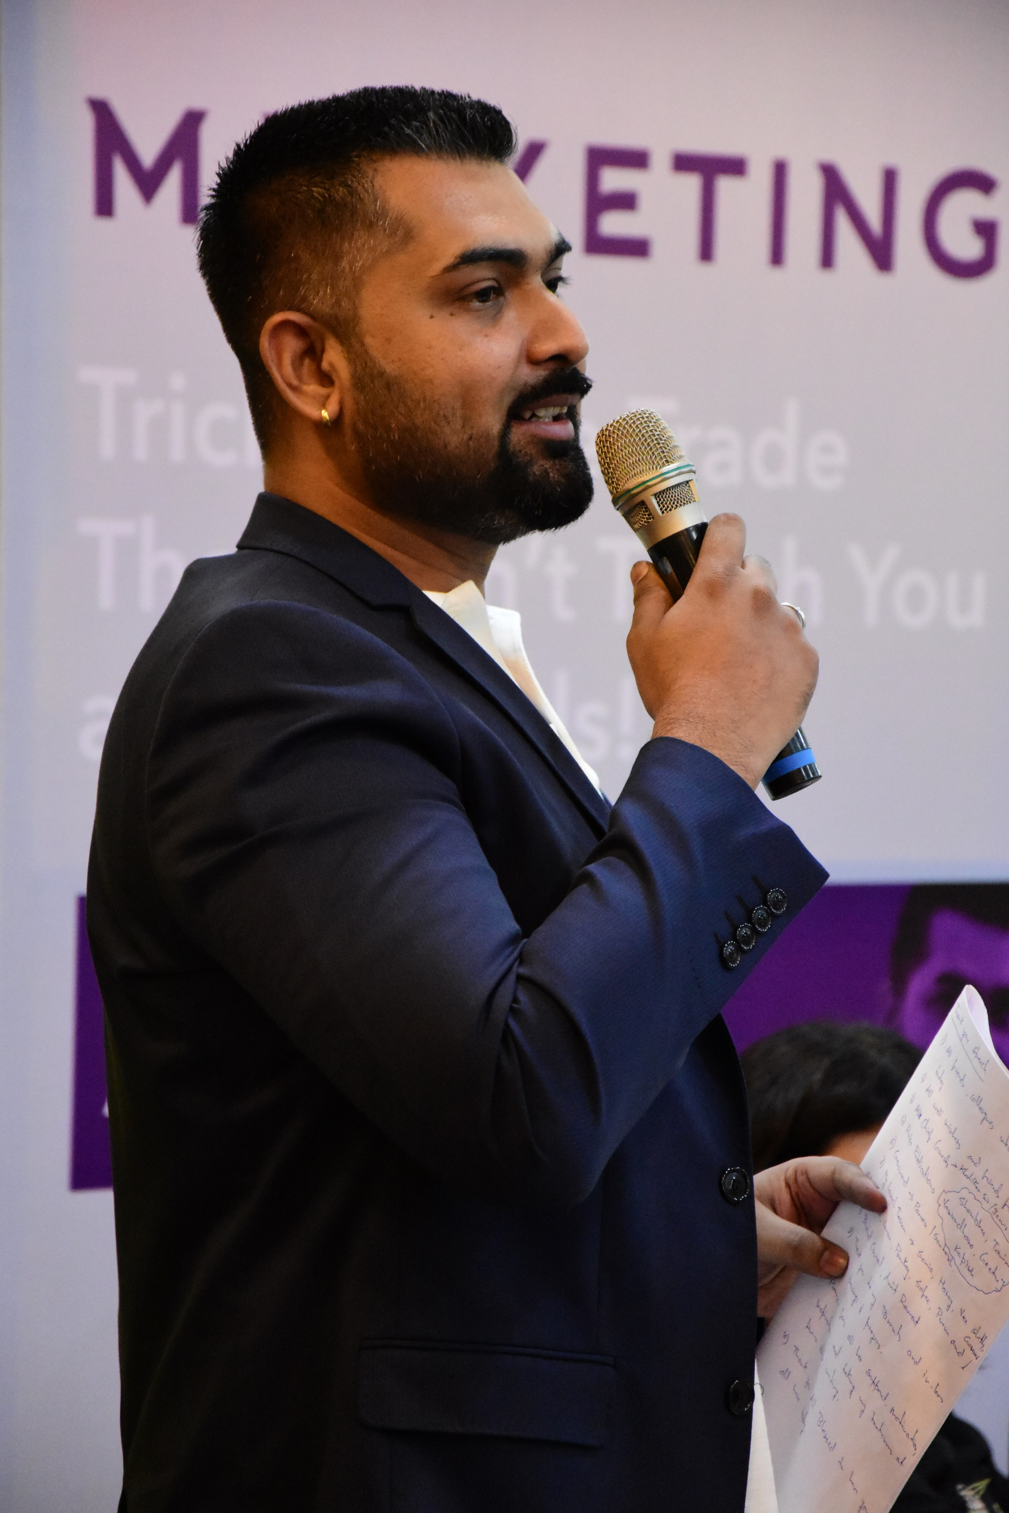
Emcee/ Anchor
Adit Chouhan

Slide 2
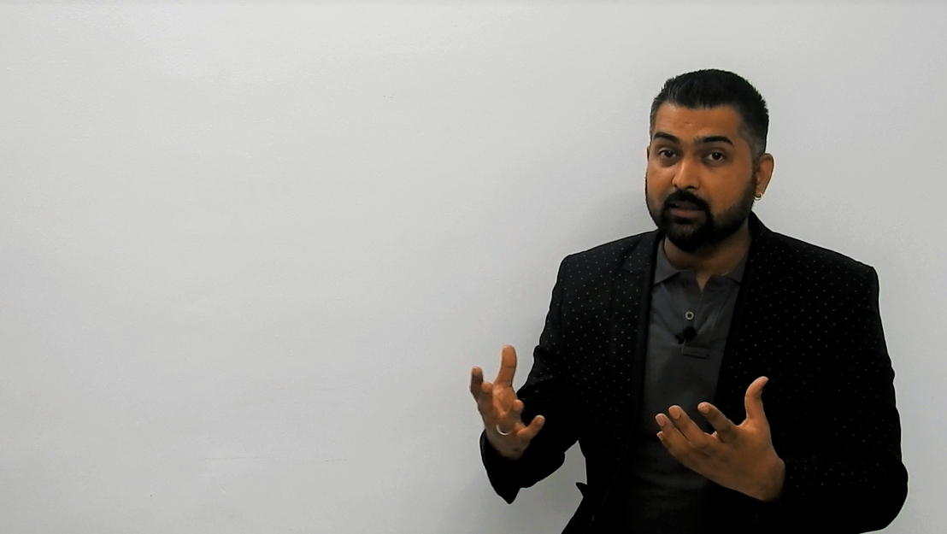
What do I bring to the Table for you?
“I take full responsibility of your Event’s smooth flow once I take control of the stage.”
“I spend those extra hours to understand what is your expectation from the event and what is it that you want to achieve through the event.”
“I work with you as a Partner and walk that extra mile for you to ensure that you know your event is in safe hands.”
“I bring with me more than 12 years of experience working with Corporate Events, Club Gigs, Fashion Shows, Launches, Concerts, Weddings and Private Parties.”
“Other perks of having me host your event are a matured personality with a voice that you will fall in love with. And wit that will keep your attendees both Engaged and Entertained.”

Slide 3
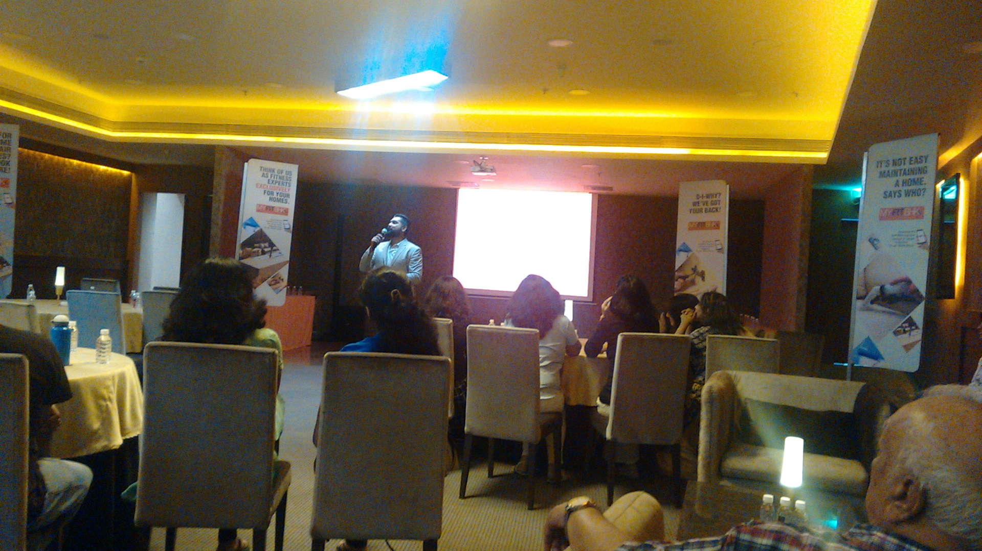
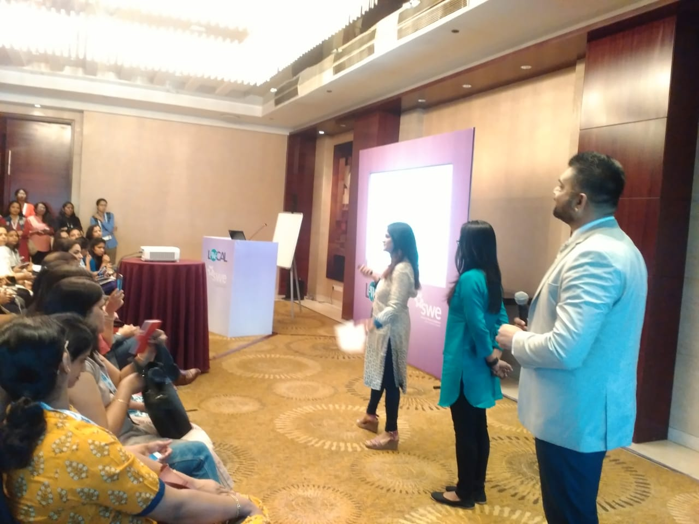
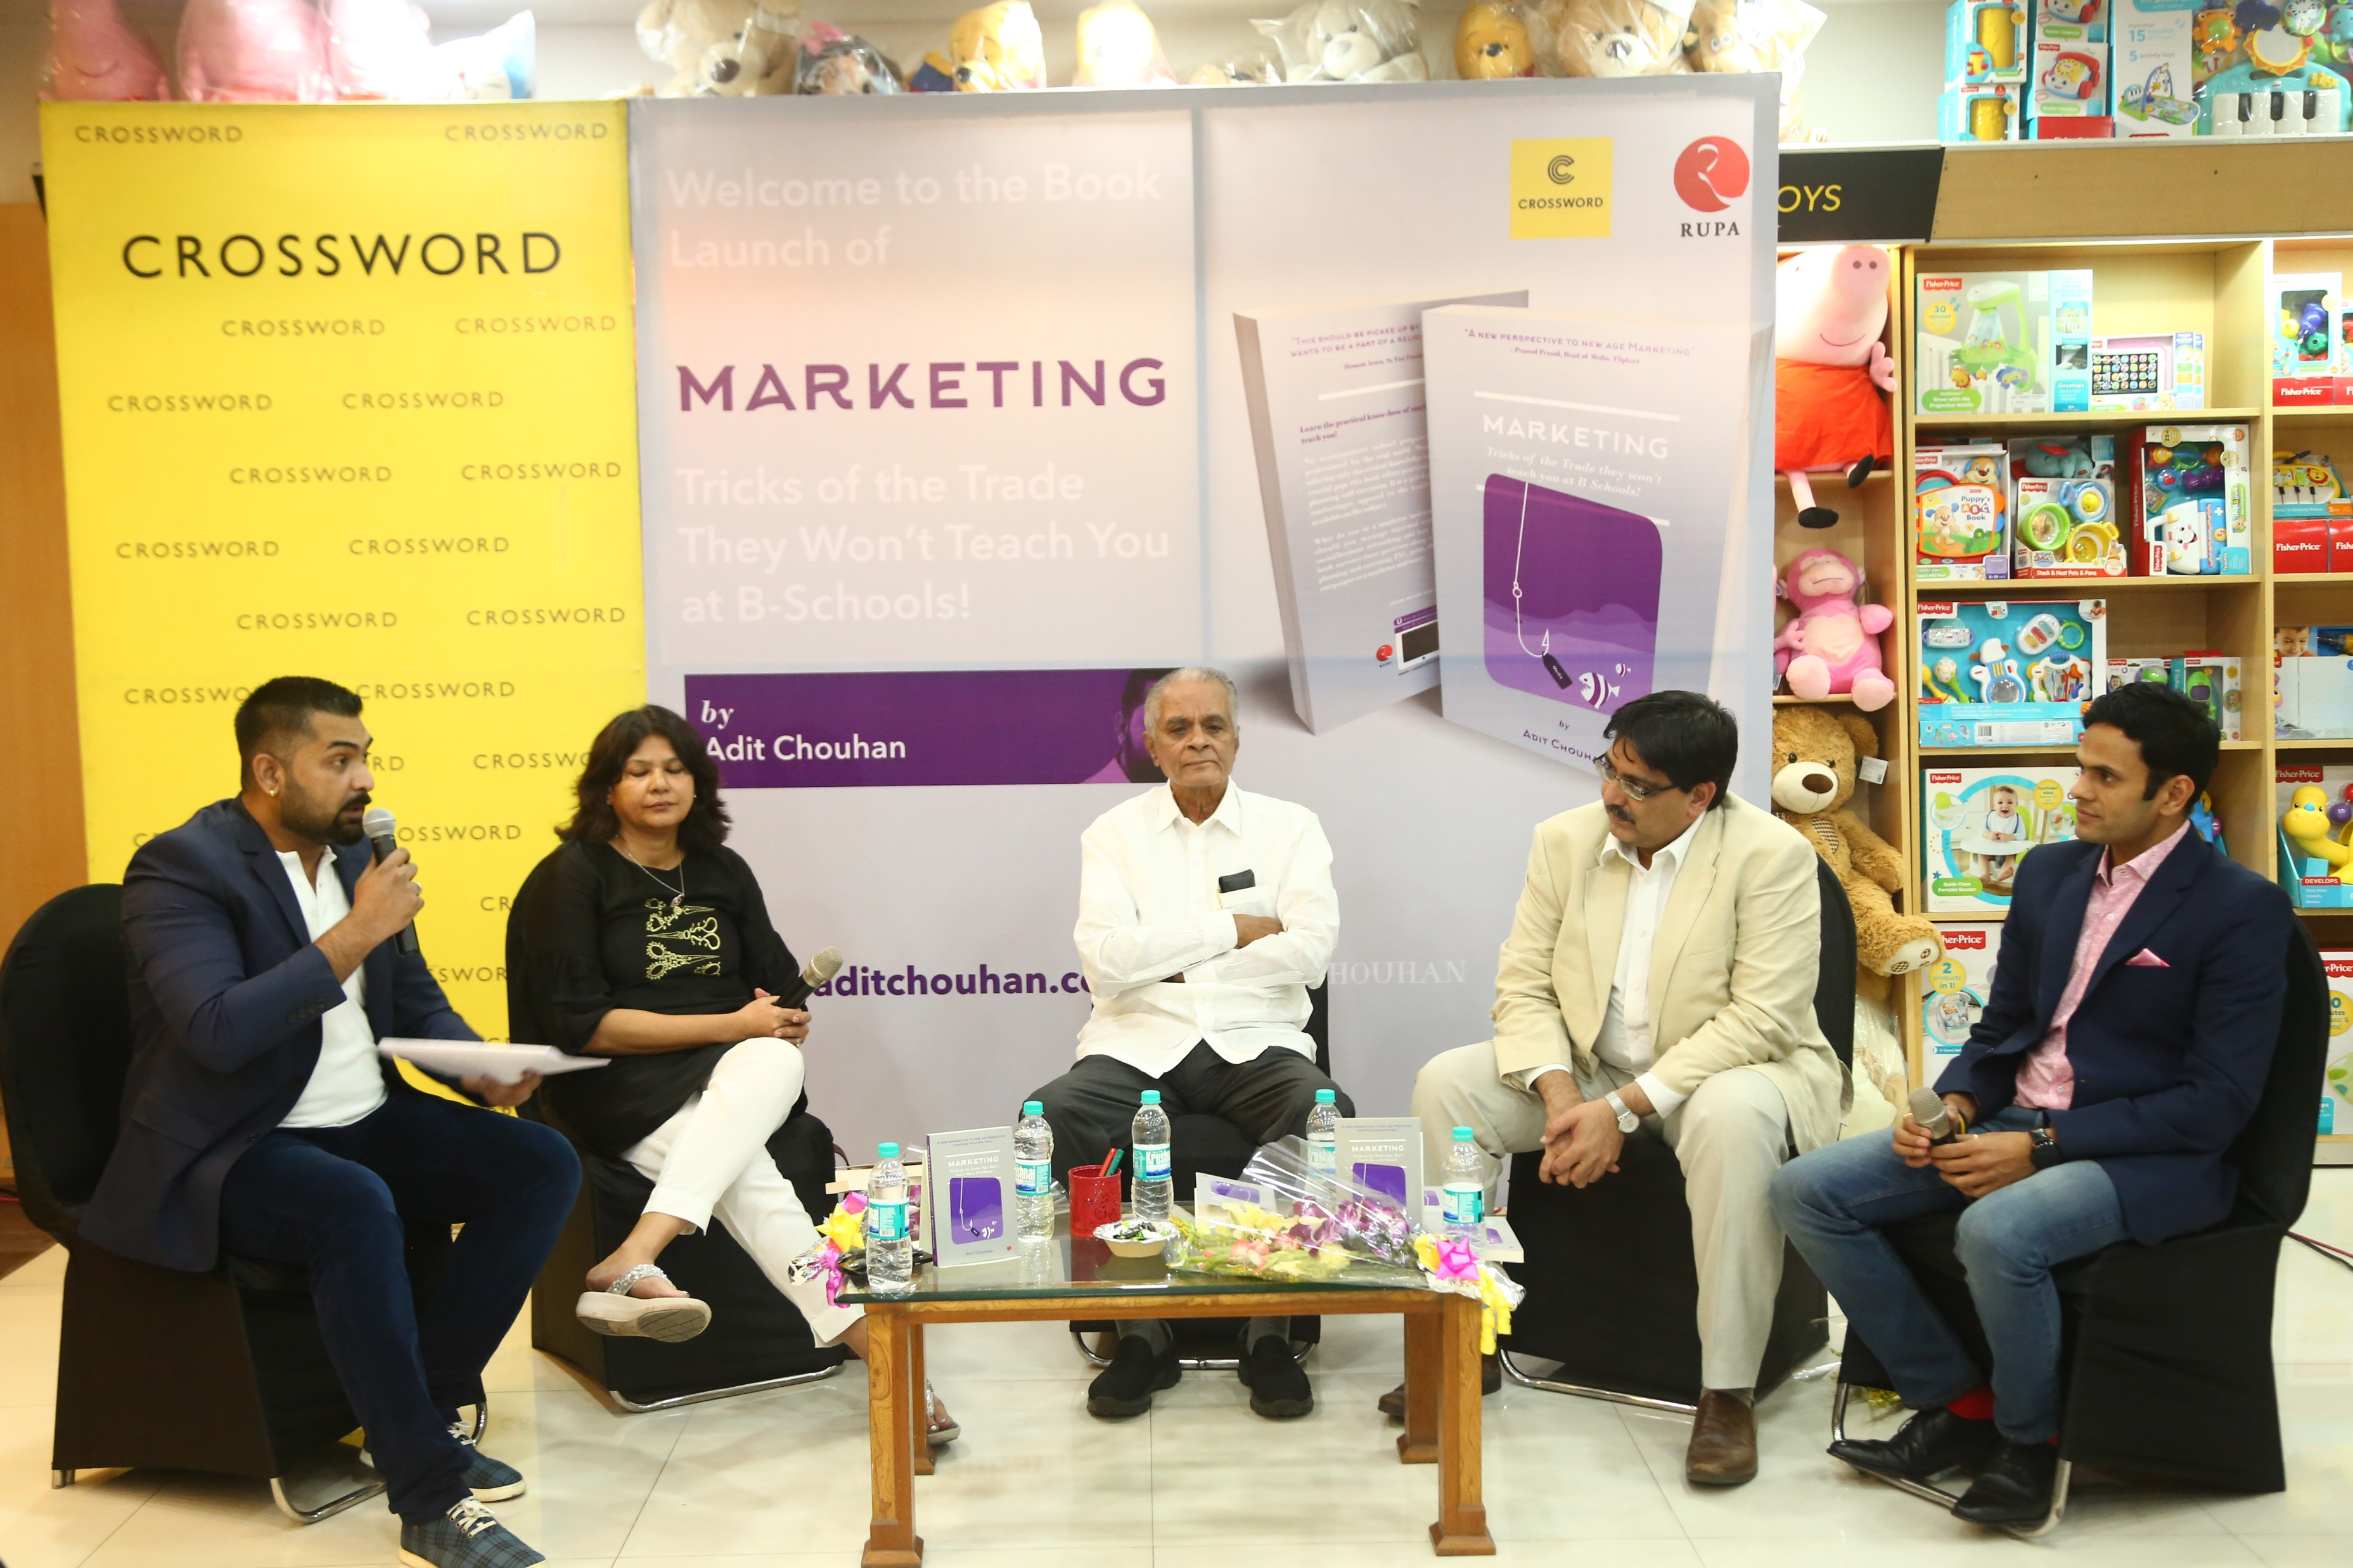
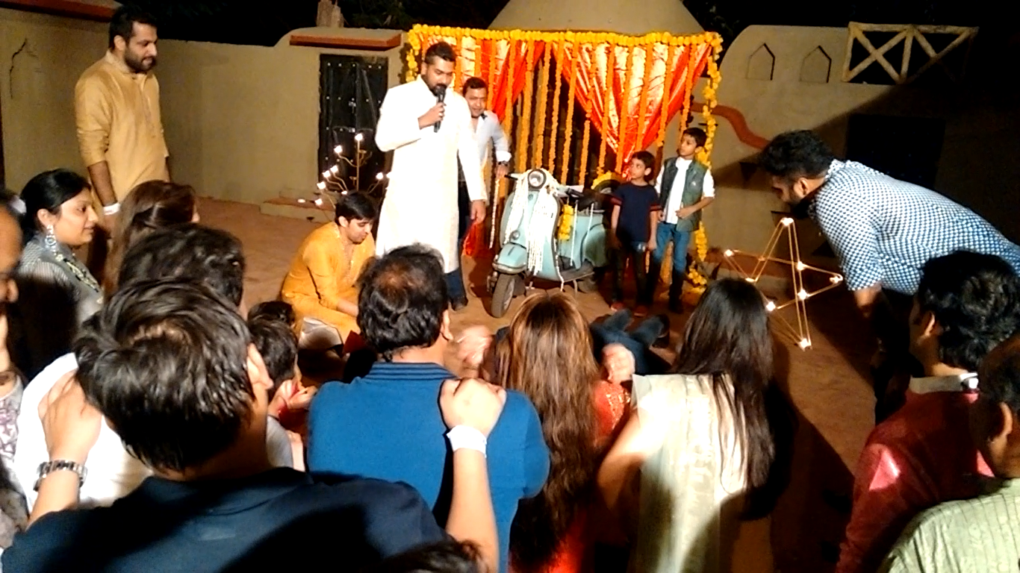
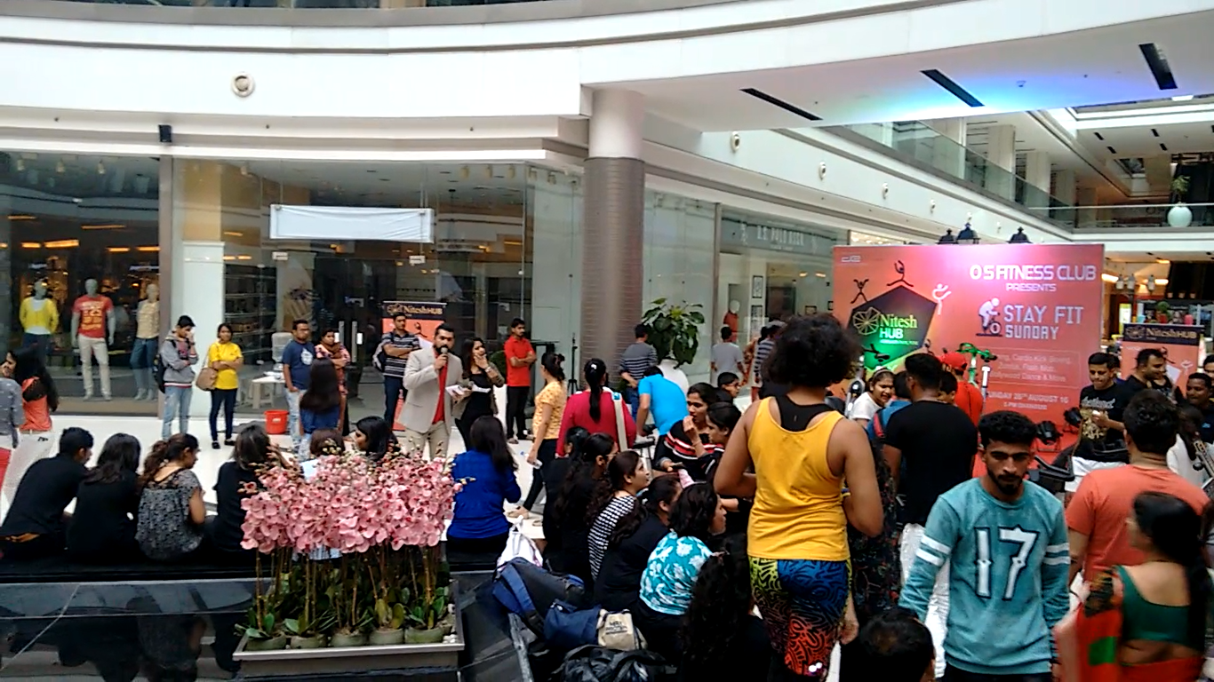
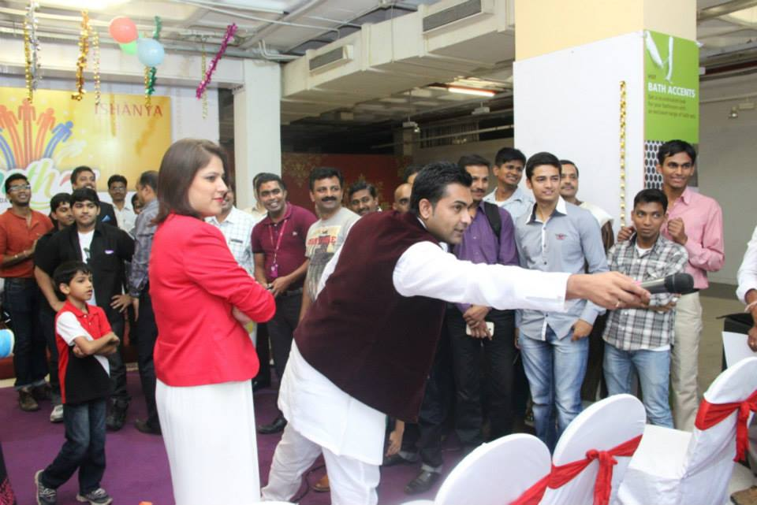
Type of Events
Corporate Events, Annual Awards, R&R
Conferences, Seminar, Workshops
Panel Discussions, Product/ Book Launches
Birthday Parties, Weddings, Mehndi
Mall Events, Concerts, Live Shows/ Gigs
Team Building Outings/ Outbound Trainings

Slide 4
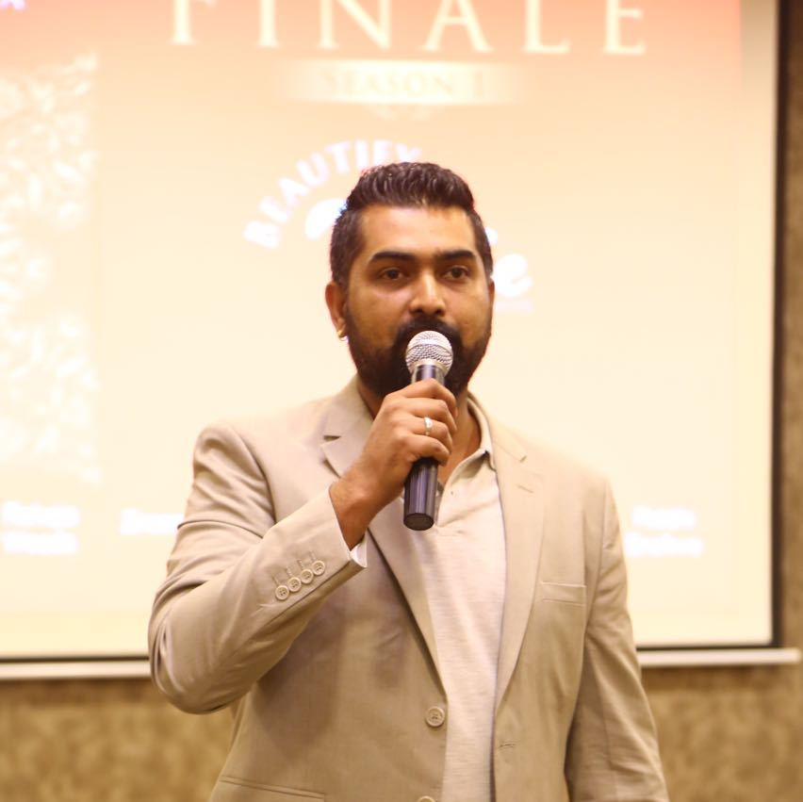
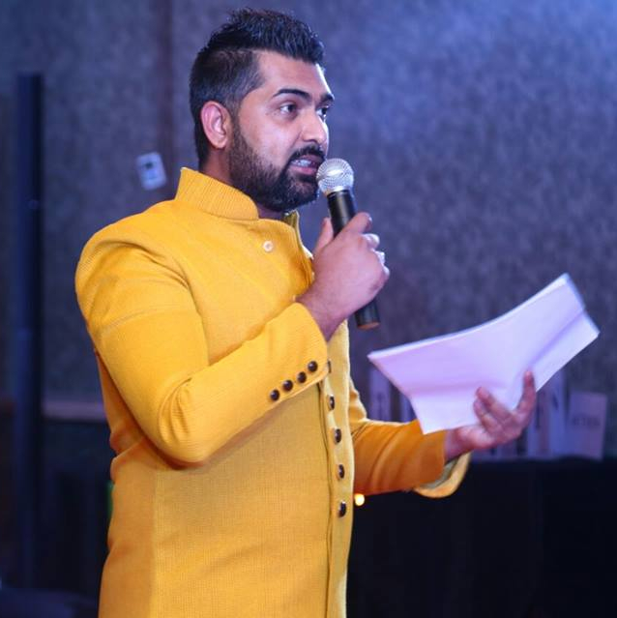
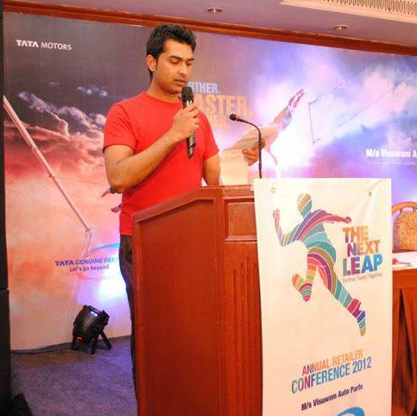
Work Mode Glimpses

Slide 5
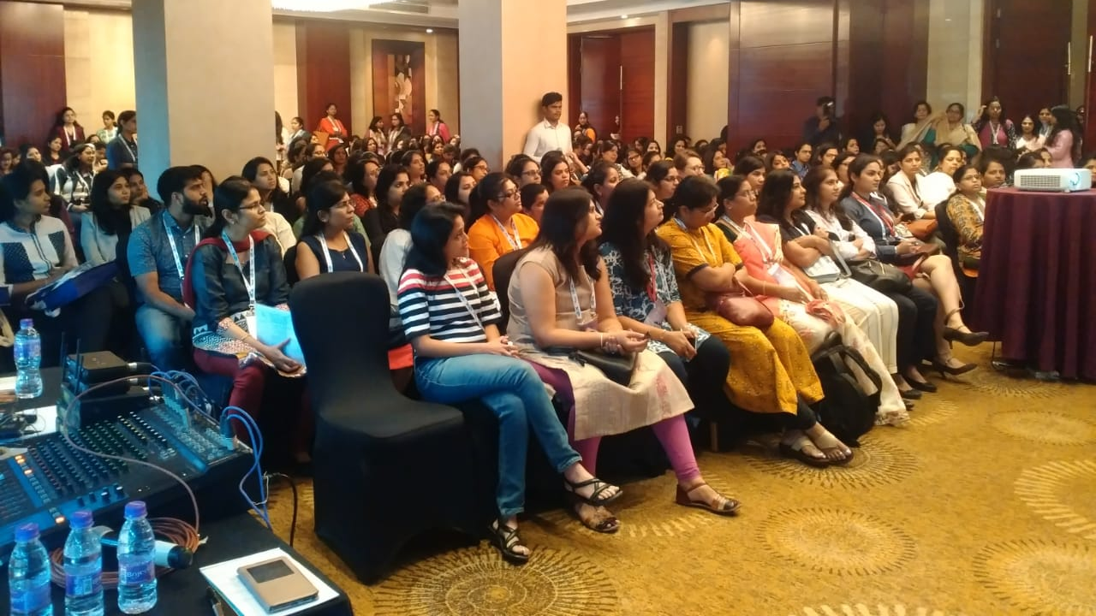
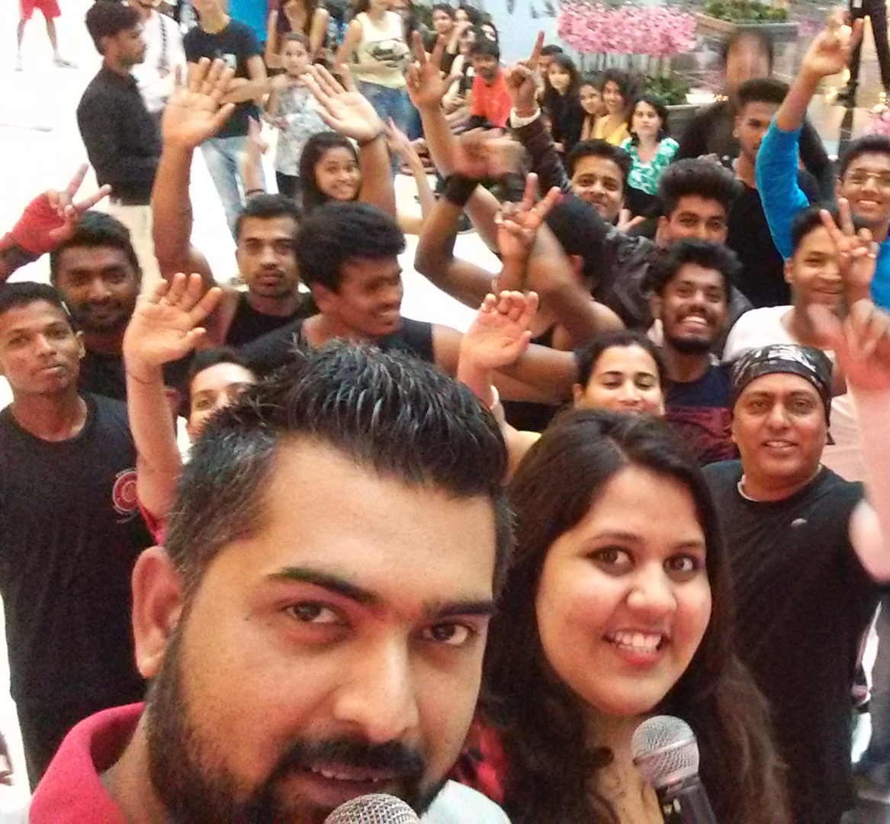
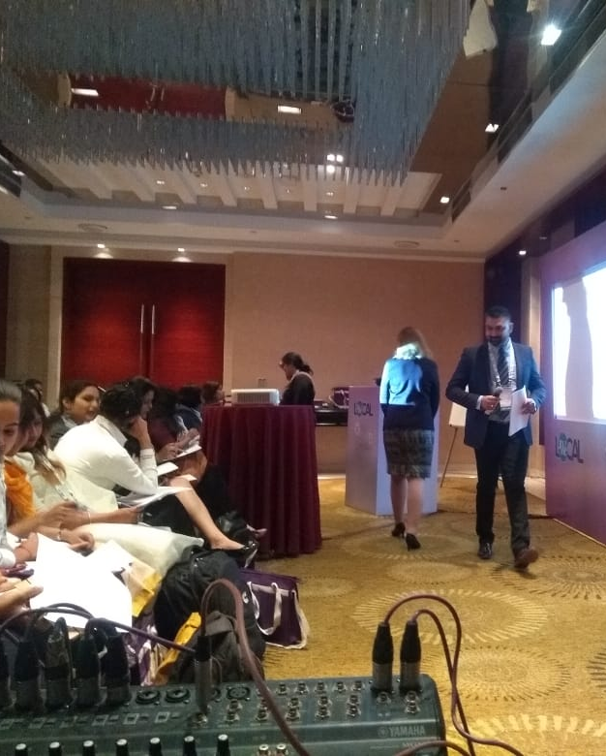
Work Mode Glimpses

Slide 6
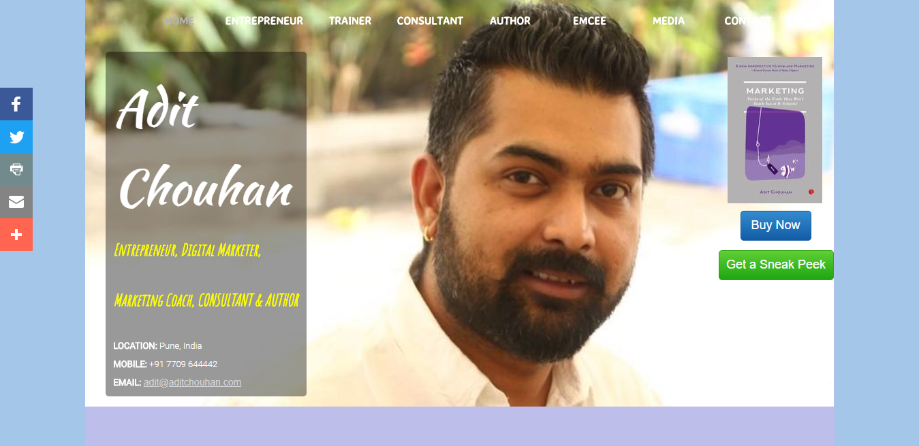
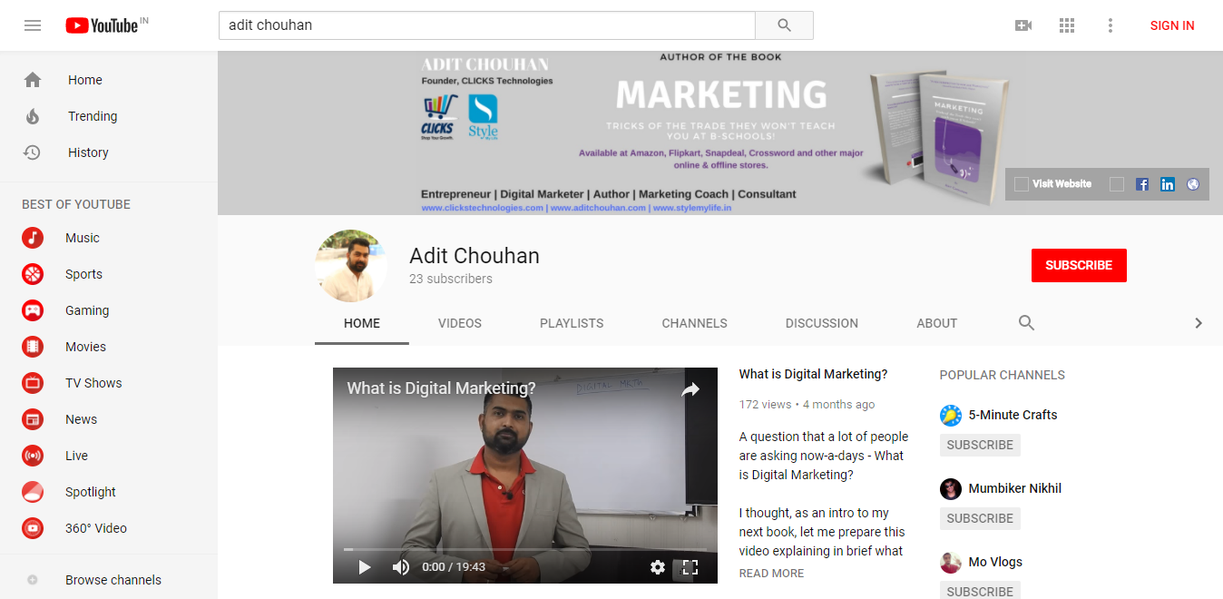
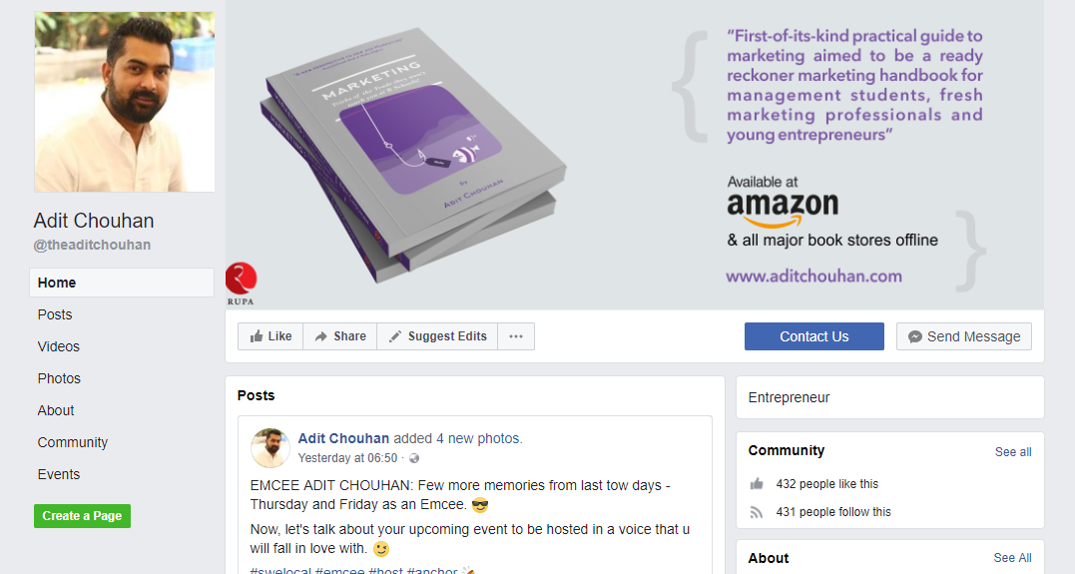
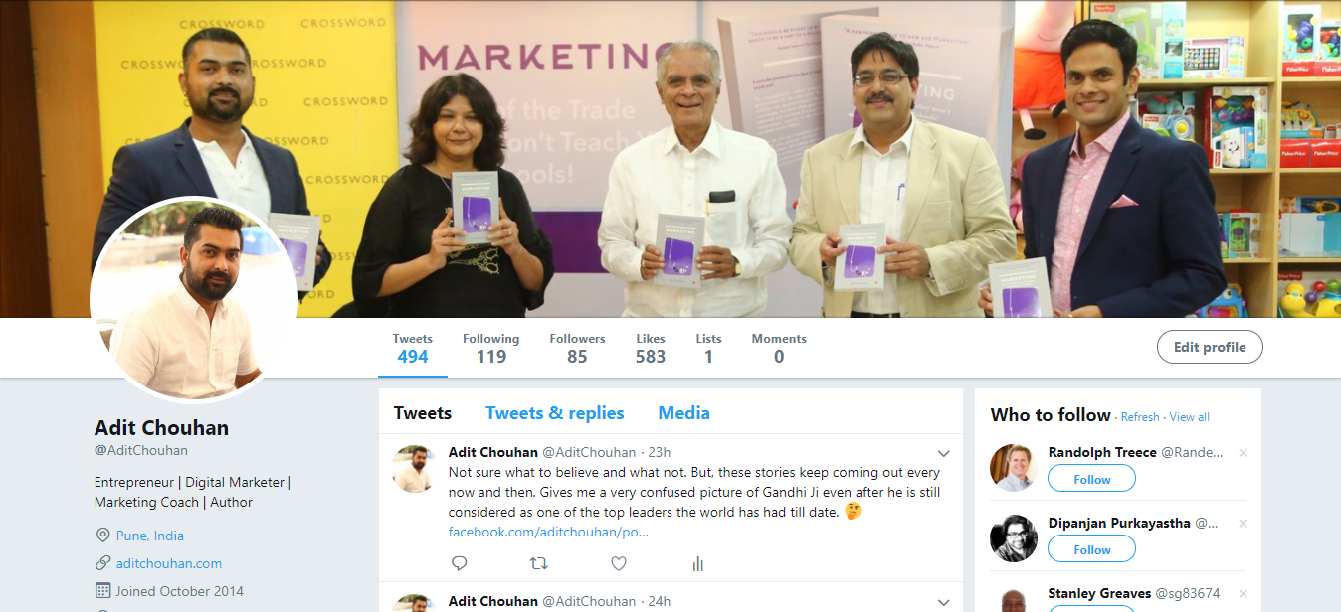
My Social Channels – CLICK ON THESE
Facebook Page
Website
YouTube
VO Samples available on demand
Twitter
Voice Over
LinkedIn

Slide 7
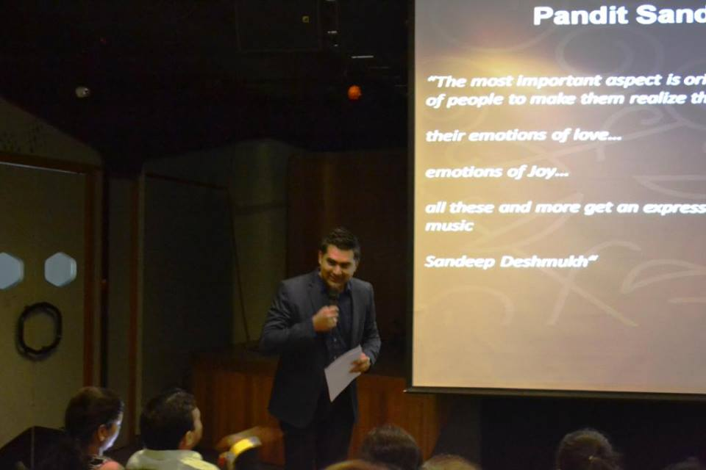
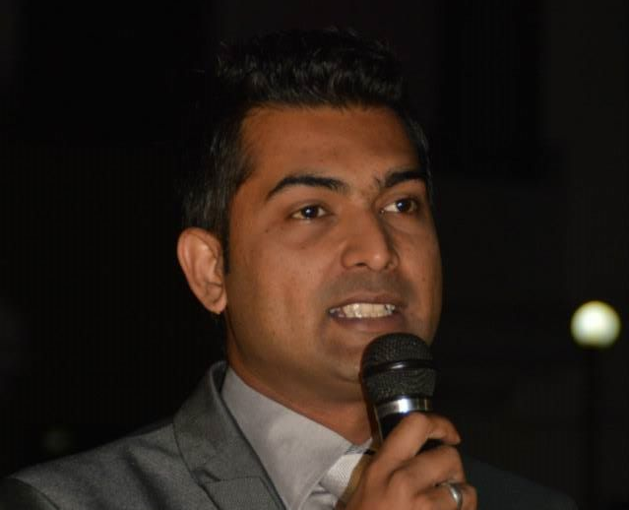
Lets Create our Special Moments. Lets Work Together.
CALL. TEXT. WHATSAPP. 7709 644442.
MAIL. adit@aditchouhan.com
See more of my latest work at www.aditchouhan.com

Slide 8
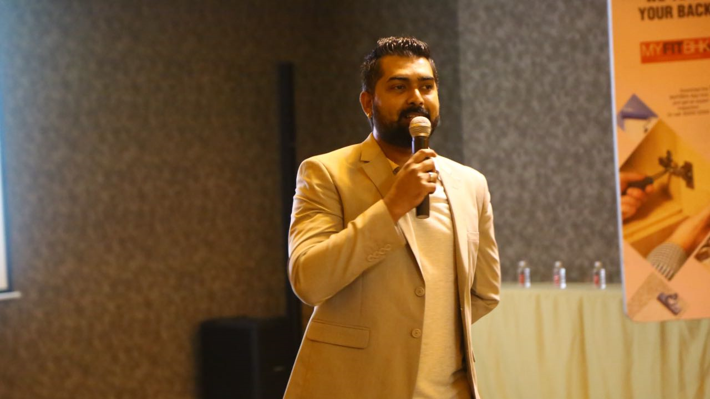
Thank You.
Look forward to work with you soon.

